Slide 1


Cloudy Middleware
Mark Little <mlittle@redhat.com>

Slide 2

Agenda
© 2011 Red Hat, Inc. All Rights Reserved.
Notes:
Why PaaS: -> our “PaaS 101”
why PaaS (in general) -- what is the idea?
contrast to DevOps
why (developers), why (ops)
what is the PaaS “sweet spot” (in particular) -- when should you definitely be thinking about PaaS?
what should you look for in a PaaS
our vision of PaaS
(and also: what applications are we talking about)
-> all that from a practitioner’s (as opposed to business) perspective
but still “philosophical”, so interrupt by all means
JBoss PaaS
OpenShift PaaS offering
Demo walkthrough
(using screenshots)
! workshop/contest this afternoon at 4:15 in the Cloud Pavilion
plenty of opp to get hans-on

Slide 3

“Cloud” was inevitable
There are already more mobile devices than computers
There are 4x more processors on the planet than people
  Most have TCP stacks
    dsPIC33FJ12GP 16-bit microcontroller has as much horsepower as a VAX (40MIPs), can handle 16+ sensors, and is 1/8 the size of a penny
  Ubiquitous computing is here to stay
Multi-core technologies will only increase
Machine-to-Machine communication will dominate all other traffic
JBoss JavaOne 2010 Booth Session | Mark Little

Slide 4
Cloud (PaaS) as the death of middleware?
Many commonalities between “traditional” middleware and Cloud-based
Extending JEE implementations to be arbitrarily scalable would suffice
  Virtual middleware stack
  Add billing
Obviously Java is not the only application language
  Therefore JEE is not sufficient for everyone
  But Java is the dominant non-Microsoft language
JBoss JavaOne 2010 Booth Session | Mark Little

Slide 5
Current PaaS approaches
Far too simplistic
  Not standards based
  Little relevance to existing middleware offerings
  Restricts application capabilities
    So much for dynamic elasticity
    Existing s/w investments are irrelevant
Limitations are not based on architectural issues
  Security implications
Vendor lock-in dominates
© 2011 Red Hat, Inc. All Rights Reserved.

Slide 6
Present and future directions
Build on our existing implementations
We must provide a natural upgrade path for existing users
  We cannot afford to repeat the DCE/CORBA, DCOM/.NET or CORBA/J(2)EE days
Evolution rather than revolution
Today “Cloud” means “servers”
  More processors outside of “servers” than inside
© 2011 Red Hat, Inc. All Rights Reserved.

Slide 7
JBoss PaaS
Users will want to deploy existing applications more dynamically to cloud environments
  Traditional on-premise, standards-based Java
  Want to be able to use existing programming models to deploy traditionally and within cloud environments
  Interoperability between traditional and cloud
Red Hat will create a PaaS offering that will use standard programming technologies to bridge the worlds of on-premise and cloud deployments
  Support the needs of cloud only PaaS opportunities while protecting customers from programming model and API changes
© 2011 Red Hat, Inc. All Rights Reserved.

Slide 8
JBoss PaaS Principles
Address existing JEE/Java deployment plus cloud
Use existing components of the JBoss portfolio – don’t reinvent the wheel
Don’t invent a closed, proprietary system with new APIs – don’t have to change the programming model
Deploy current JEE/Java on-premise plus cloud deployment
  Make them inter-operable (Future proof investment)
  Deployment environment “agnostic” (elastic)
© 2011 Red Hat, Inc. All Rights Reserved.

Slide 9
JBoss PaaS Principles
Developer Centric
  PaaS enable from the viewpoint of the developer
    CDI
  Integrate tooling for cloud D&D with JBDS
  Make easier for developers to use cloud
Standards Based
  Support PaaS and other cloud standards as they exist
  Define or drive standards where they don’t exist
    JSR 347
© 2011 Red Hat, Inc. All Rights Reserved.

Slide 10
JBoss PaaS Principles
Optimize for Red Hat IaaS offerings and leverage
Market needs addressed by JBoss PaaS:
  Lower costs – greater utilization of resources on demand
  Make deployment easier and more abstracted
  Elasticity to scale on demand
© 2011 Red Hat, Inc. All Rights Reserved.

Slide 11
JBoss PaaS capabilities
Elastic runtime
  Utilize more compute/storage capacity automatically
  JEE services as true services, not co-located within same VM/Container
Development
  Runtime hosted as a service in cloud (test deploy)
  Develop (tools) locally – then deploy in Cloud
Abstraction to all configuration considerations
  Data store, clustering, network, security services
  Automatic deployment
  Workflow for deployment
© 2011 Red Hat, Inc. All Rights Reserved.

Slide 12
Services, VMs and JVMs
Machine A
Machine B
Machine C
Service
VM
JVM
Java EE services (in blue) split across machines, VMs and JVMs
Service instance may abstract more cloud instances
  Hierarchical structure of machines, VMs etc.
Similar deployment structure for applications
© 2011 Red Hat, Inc. All Rights Reserved.

Slide 13
JBoss PaaS futures
Lifetime application management (tool chain)
  Works across on-premise & clouds
  Supports heterogeneous deployments
  Build time tools
  Deployment tools
  Ongoing operational & management tools
Developer tools (IDE)
  Expansion of developer tools for easier seamless development
© 2011 Red Hat, Inc. All Rights Reserved.

Slide 14
How are we going to do it?
Stage 1
  Begin with JBoss EAP and development tools
  Concentrate on the application platform
Stage 2
  Incorporate other “integration” technology for PaaS enablement – ESB, BPM, presentation technologies
  SOA natural architectural approach for PaaS/SaaS
© 2011 Red Hat, Inc. All Rights Reserved.

Slide 15
OPENSHIFT

Slide 16
OpenShift
Two interaction models:
OpenShift Express
  “Runtime-as-a-Service”: simple, git-based interaction
OpenShift Flex
  “Middleware-as-a-Service”
  Optimized for existing models
    Nodes
    Middleware, frameworks, services
    Software ecosystem
  Operations use cases: self-serve, user management
© 2011 Red Hat, Inc. All Rights Reserved.
Notes:
Now, in Openshift this takes on 2 forms

Slide 17
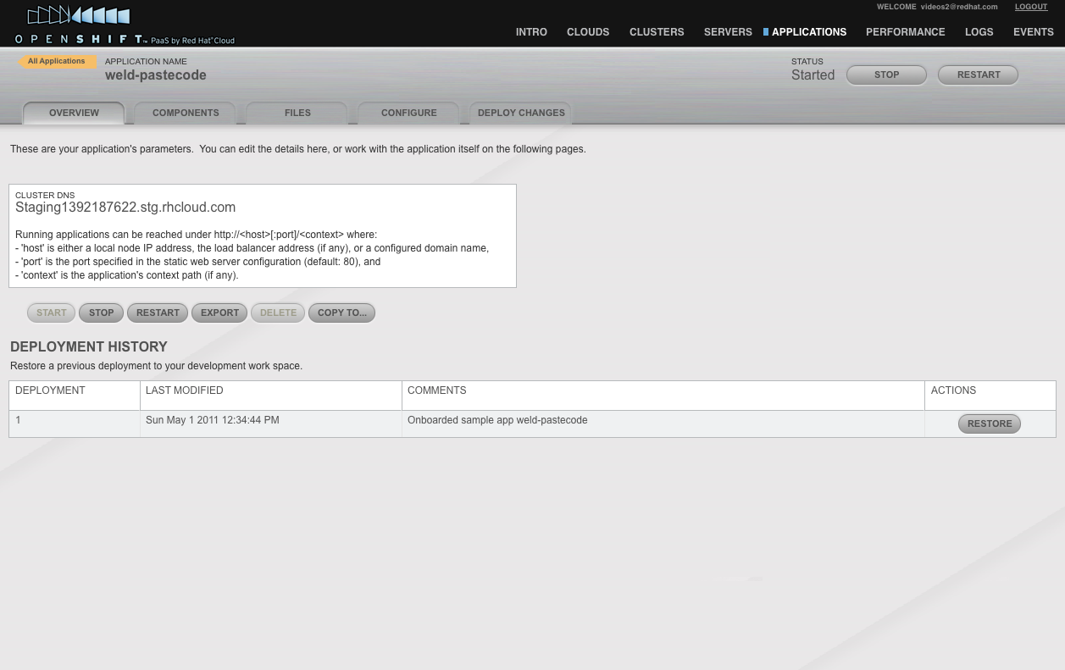
Application Overview
© 2011 Red Hat, Inc. All Rights Reserved.

Slide 18
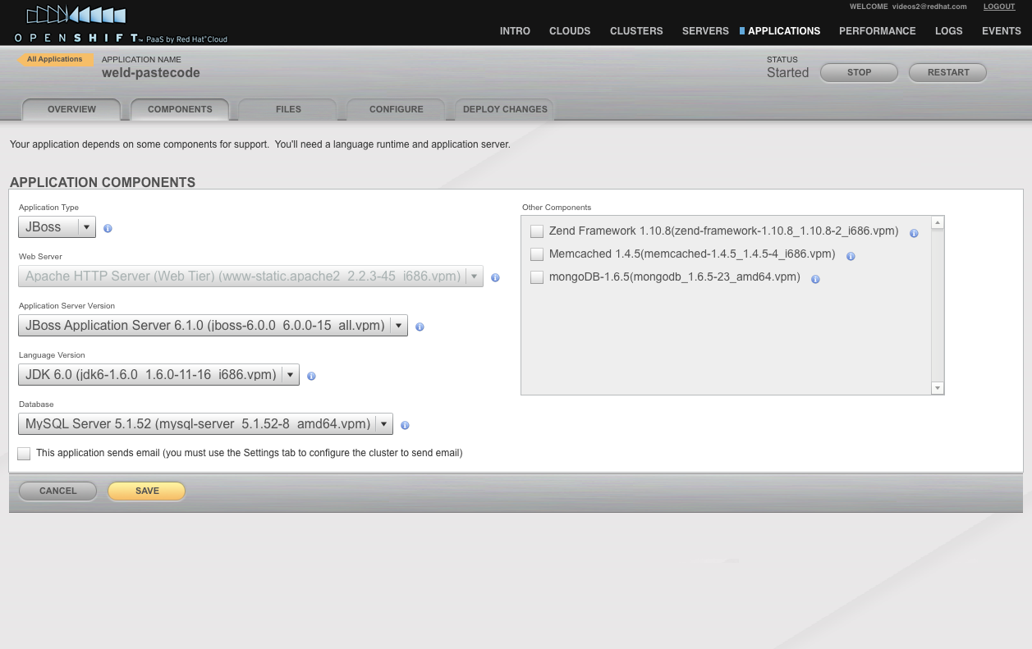
Component Selection
© 2011 Red Hat, Inc. All Rights Reserved.

Slide 19
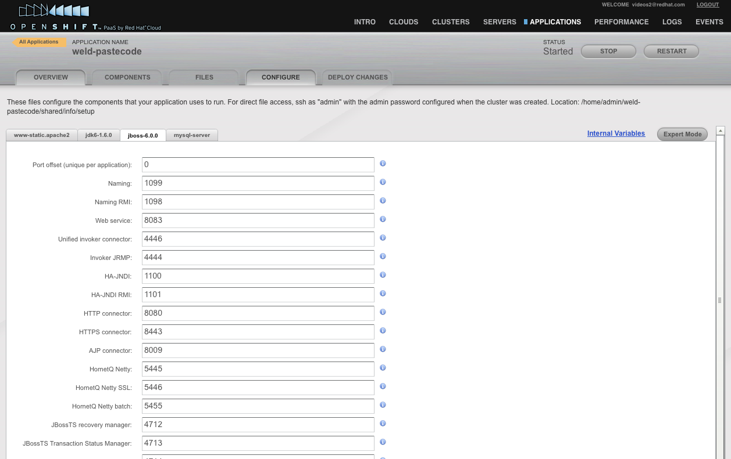
Configuration
© 2011 Red Hat, Inc. All Rights Reserved.

Slide 20
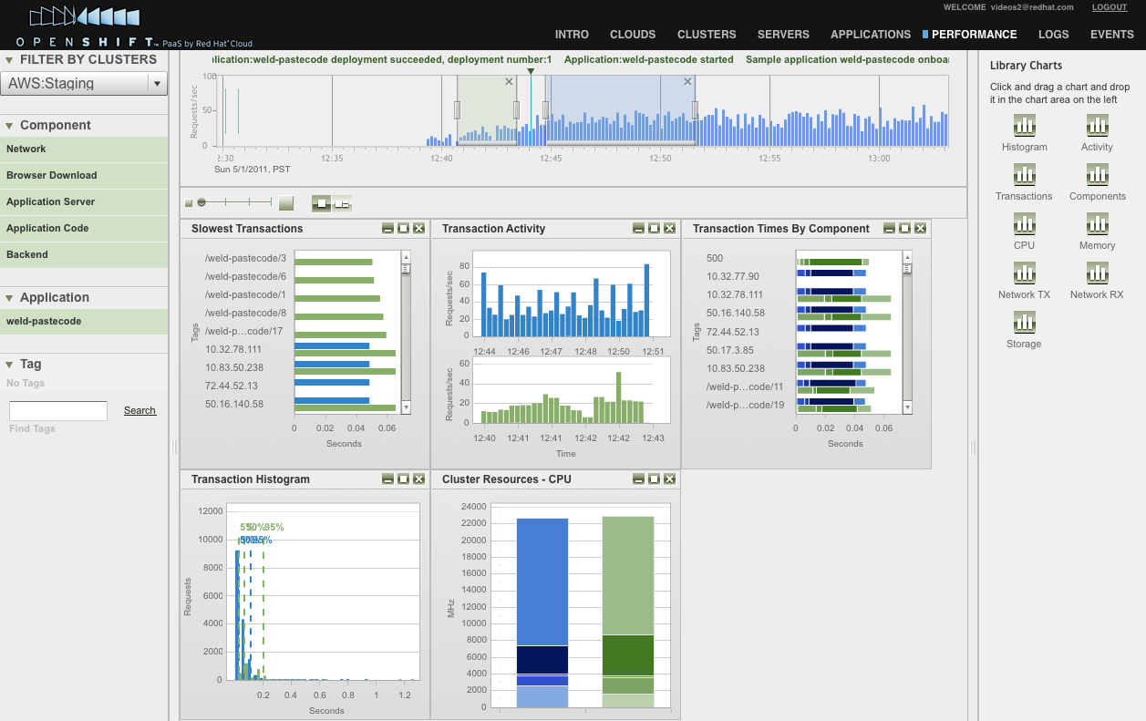
Performance Monitoring
© 2011 Red Hat, Inc. All Rights Reserved.

Slide 21
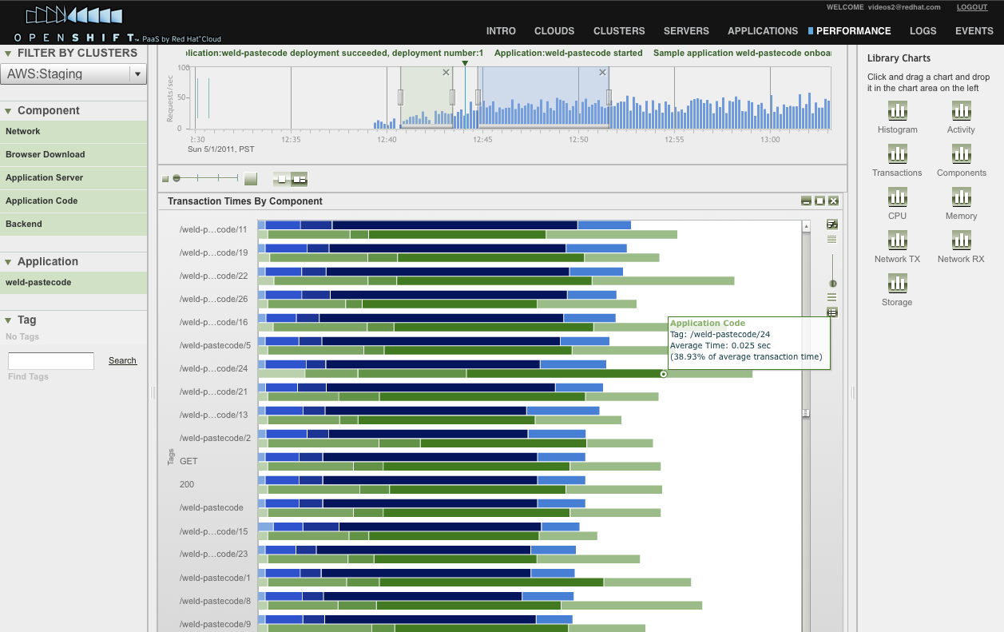
Transaction Monitoring
© 2011 Red Hat, Inc. All Rights Reserved.

Slide 22
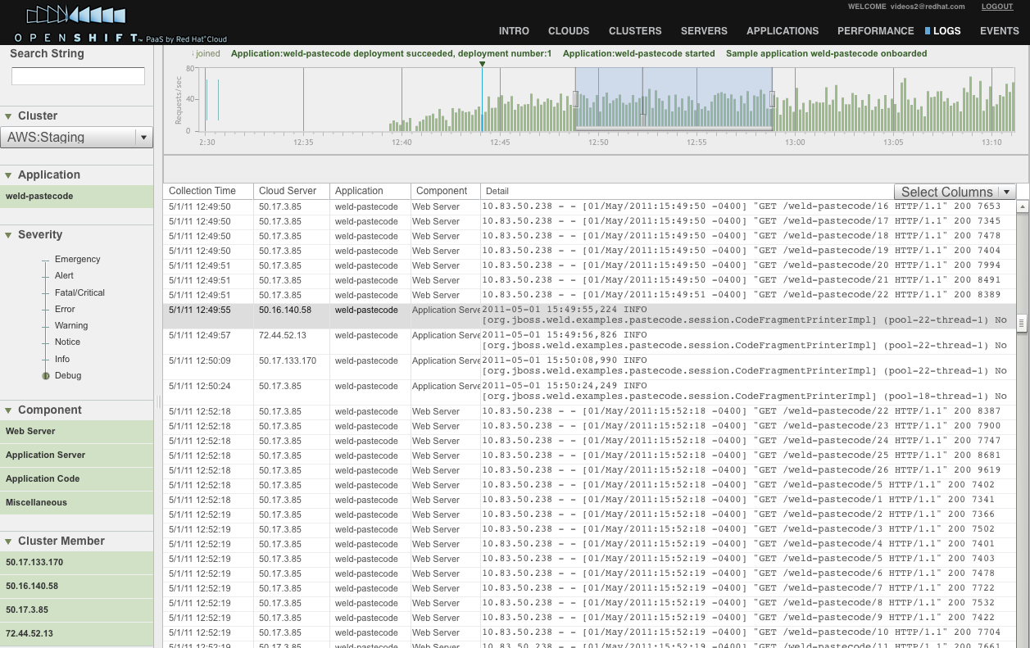
Log Management
© 2011 Red Hat, Inc. All Rights Reserved.

Slide 23
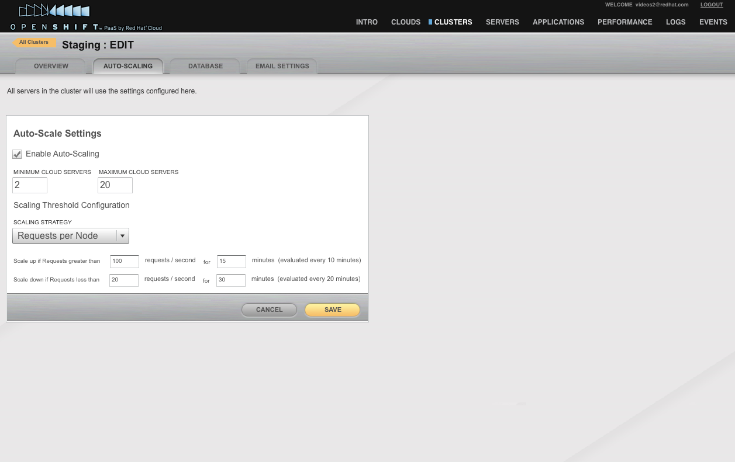
Auto-Scaling
© 2011 Red Hat, Inc. All Rights Reserved.

Slide 24
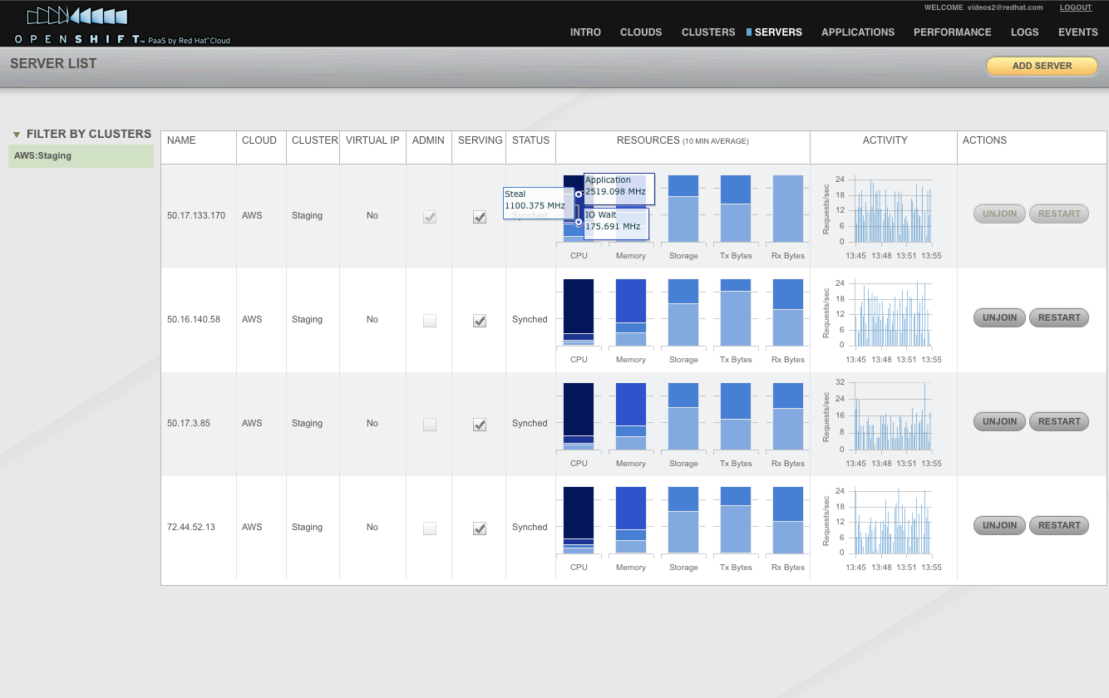
Server Monitoring
© 2011 Red Hat, Inc. All Rights Reserved.

Slide 25
Conclusions
Ubiquitous computing will increase and evolve
We cannot afford to track multiple platforms
We must define a single platform that caters for a range of deployment environments
  Core requirements same, implementations change
  Dynamic adaptability
  Single machine deployment as a degenerate case
  Support bidirectional flow of applications
Define a new platform that builds on current
  Future proofing investments for customers
© 2011 Red Hat, Inc. All Rights Reserved.

